Slide 1
TRADING SOLUTIONS PMO Project: atlas-CFD
1 // 11// 2016
Private & Confidential
Notes:
1

Slide 2
TABLE OF CONTENTS
PROJECT OBJECTIVE & SCOPE
ROLES & RESPONSIBILITIES
STAKEHOLDERS
COMMUNICATION PLAN
ROADMAP
PROJECT STATUS (with Risks/Issues)
MILESTONE STATUS
CHANGE CONTROL REQUEST
APPENDIX

Slide 3
PROJECT objective & SCope
The goal of this project is to provide users with the ability to trade, maintain positions, and calculate P&L on cross currency CFDs, more specifically cross currency Single Name Equity Total Return Swaps. This functionality will be added while maintaining the existing simple trade capture workflow that AIM users currently employ.
In Scope:
Trade capture screens – must be updated to pass the CFD and reference security currencies and exchange rates needed for valuation and position keeping, as well as converting the price field reflect the currency of the CFD. Position management – must still be able to roll up cfd and non-cfd positions P&L calculation – must be able to accurately calculate FX P&L exposure in the CFD currency. P&L display – must be able to display cfd p&l in; CFD currency – converted to account currency and then reported in worksheet currency Reference security currency – converted to account currency and then reported in worksheet currency
Out of Scope:
Mixed CFD and cash orders – orders where some allocations are settled in cash and other allocations are cfds. Transaction costs – transaction costs are not currently included in total cost. Reset flexibility – individual swaps can have unique interest rates, calculation and reset terms. Corporate actions – when the reference investment is impacted by a corporate action (i.E . a dividend) swaps written against it reflect the impact as well. Financing accruals – calculation of the fees paid to enter into a swap Financing cash flow – payment of the fees Rate resets – update of the rates used to calculate the financing payments P&L resets – certain CFDs reset the amount that they accrue on, and actually realize some of the P&L through the life of the CFD. Margin – movements of collateral to support the cfd ownership.

Slide 4
Roles and responsibilities
TEAM MEMBERS | ROLE | RESPONSIBILITIES
John Buscema | Business Program Lead
Mousuf Chowdhury | Product Manager | Makes strategic decisions regarding product vision, strategic prioritization and product resource allocation. BPM & Corporate Actions
John Frohnhofer | Product Manager | Makes strategic decisions regarding product vision, strategic prioritization and product resource allocation. Position, P&L +CFD
Justin Woddis | Product Manager | Makes strategic decisions regarding product vision, strategic prioritization and product resource allocation. Business Model
Anthony Mitzak | Product Analyst | Writing requirements and daily scrum
Dan Distler | Product Analyst | Writing requirements and daily scrum
Jodi Tarza | Product Analyst | Writing requirements and daily scrum
Mark Daisley | Project Manager | Responsible for communication, including status reporting, risk management, escalation of issues that cannot be resolved in the team, and, in general, making sure the project is delivered on schedule, and within scope.
- | Quality Assurance Team | Responsible for initiating and implementing necessary test plan based on project requirements & communicating test metrics.
Cut this list down
TEAM MEMBERS | ROLE | RESPONSIBILITIES
Jeff Tyler | R&D Program Lead | Responsible for build and delivery of software
Vasanth Kumar | R&D Lead | Responsible for build and delivery of software – Positions, P&L
Suvankar Mazumder | R&D Lead | Responsible for build and delivery of software – Business Model
Colm Reilly | R&D Lead | Responsible for build and delivery of software – Backend processes
Ajay Roopchansingh | Project Manager | Responsible for build and delivery of software – Transactions and blotters

Slide 5
Stakeholders Outside of team
Name | Position
Ray Tierney | Program Sponsor
Christina Villa | TS COO
Jessica Hatch | Go-to-market
Ken Sherman | PMO
Rebecca Tayne | Buyside COO
Eric Lewin | Sellside COO
David Weisburg | CRO
Palak Patel | AIM Product
Sunil Biswas | TOMS Product
Linda Middleditch | SSEOMS Product
Shawn Edwards | CTO
Vlad Kliatchko | Technology
Stig Sorensen | R&D AIM
Peter Levesque | R&D TOMS
Chow Lee | R&D SSEOMS
Name | Position
Shawn Edwards | CTO
Vlad Kliatchko | Technology
Sergey Tarsis | Technology
Joe Bruzzese | Technology
Ben McDonald | Core Product
Jose Ribas | Core Product
Karim Faraj | Core Product - Derivs
Denis Duchene | Core Product - Derivs
Harald Collet | BVault
Maor Avidor | R&D Analytics (MARS)
Bill Scheurer | AIM Business Dev
Cut this list down

Slide 6
Communication/governance plan
 | OBJECTIVE OF COMMUNICATION | MEDIUM | FREQUENCY | AUDIENCE | DELIVERABLE
KICK OFF MEETING | Introduce the project team and the project. Review project objectives and management approach. Start the work. | Face to Face | Once 12/17/2015 | All Atlas R&D All Atlas Business | Workflow Review Key Build requirements Risk/Issue log kick-off
PROJECT TEAM METINGS | Review status of the project with the individual teams. | SCRUM | Daily | Project Team | Agile
TECHNICAL DESIGN MEETINGS | Discuss and develop technical design solutions for the project. | Face to Face | As Needed | Project Technical Staff | Agenda Meeting Minutes
MONTHLY PROJECT STATUS MEETING | Report on the status of the project to management. | Face to Face Conference 3W3 | Monthly – 2nd Thursday of each month | All Atlas R&D All Atlas Business Open to product stakeholders | Review status from the PMO Workbook
PROJECT STATUS REPORTS | Report the status of the project including activities, progress, potential concerns | Email | Weekly | Project Sponsor Project Team Stakeholders | Project Status Report Project schedule

Slide 7
ROADMAP
Paste here from Clarity

Slide 8
8
Project status
PROJECT UPDATE
Current Status: UAT Date: Prod Date:
Development is underway & on track with initial plan. Integration points to ATLAS will be available for use from dependent teams in the next release.
KEY ACCOMPLISHMENTS
UPCOMING ACTIVITIES
Kick off meeting held 12/17/2015
Design meeting
ISSUES & RISKS
Issue/Risk | Status | Detail | Impact | Owner
Valuations | Open | There could be discrepancies in financial values between downstream systems where one reads CFDs from the old system and the other from ATLAS e.g. MAV/REC (positions) or XPT/EMSX (execution). Research upfront any discrepancies based on how we plan to calculate financials in ATLAS. If there are, we need to tell downstream product owners and assess if they need to start integrating with ATLAS. Proposed mitigation - Book a CFD as today (underlying + flag) and second using SWPM/CFD. Compare diffs in financials of: a) orders b) trade allocations c) Positions | Incorrect numbers | Chaitanya
Scope | Open | Are Indices and Corporate Bonds in scope
Scope | Open | Would we ever have an instrument that pays (CFD Currency ) that is different from the Finance Currency?
Trade Capture | Open | Do we need a standard Identifier out to the World (Symbol & CFD flag, or other identifier?) a) Middle Office b) Core C) Trade Capture

Slide 9
9
Project status
ISSUES & RISKS – contd.
Issue/Risk | Status | Detail | Impact | Owner
Core | Open | The current strategy to solve for CFDs is to have Core create the investment, and ATLAS will then record the attributes and impacts of that investment. At this point, Core has no way of making this a "Loadable Investment"....In other words, a user will not be able to see this investment in SWPM<GO>, or run DES<GO> as they can for other investments. While we believe that this is on Core's road-map, we have no transparency into when this will be available.
Closing transactions | Open | How do we identify, do we force Lots for these products? Relief methods? R&D needs to assess if we are able to do asset servicing without requiring a ticketing model. The crux of the problem is how do we associate an unwind (sell) to the correct asset if its not explicitly stated in the ticket |  | CP
Trade Capture - EMSX | Open | What Information is EMSX passing? |  | Scott Lewis
Trade Capture | Open | When will CFD information be transmitted to Core to create the Instrument?
Trade Capture | Open | How will trades be amended / cancelled?
Valuation/Display | Open | Currently we have 3 “Cusip” (identifier) fields. Will we be using those, a unique ID from Core? Some other field?
Valuation/Display | Open | BDS? Is it different from MAV? How?
Valuation/Display | Open | If other applications use legacy sources (HFDB) they will not match the new accurate data source. Can / should we mitigate this?
Valuation/Display | Open | How will Unfilled Orders be displayed?
Core | Open | Can Core provide Local P&L on a daily basis? |  | Dennis Duchene
Core | Open | Can Core provide Local P&L on an intraday basis? |  | Dennis Duchene
Core | Open | Can core provide Base P&L |  | Dennis Duchene

Slide 10
10
Project status
ISSUES & RISKS – contd.
Issue/Risk | Status | Detail | Impact | Owner
Client | Open | First adopters or pilot clients
Client | Open | Usage metrics to prove success of functionality
Support | Open | After we go live with this project, is the expectation that all data corrections related to CFDs will be initiated by a client action within the trading system or will we need an operational back-door to manually correct data?
Ticketing | Closed | 1. Ticketing to send us the FX Rate and the Settlement currency. The fields for these already exist in the UI. We only need to start using them. 2. Changes that are purely for display purposes: Displaying the price (read-only) in settlement currency etc. This shouldn't impact ATLAS and our design can be independent of this. Current state of the world: 1. From a business requirements perspective, there are no changes that are being asked for XPT, TBLT, and CFD deal close-out / unwindings. 2. We have buy-in from Chaitanya Ravi to call ATLAS APIs during order creation / close-outs if we need it.
Cash | Closed | Need to confirm if we require having the cash impact correct (in the settlement currency) during a CFD close-out. By cash impact, I am referring to CCMS and the MAV cash position amounts being reflected correctly. Yes, I would like cash to be included in the scope of this project. (If not, then cash will most likely be wrong for any client who uses this functionality)
Order Management | Closed | Are there any requirements at all for CFDs from an order management perspective - routes, fills, portfolio allocations, execution? Aside from the fields that we are requesting (CFD to Account FX Rate, underlying security to Account FX Rate, etc. ) I am not aware of any additional requirements.
Ticketing | Closed | Settlement currency = contract currency - Yes
P&L | Closed | Do we want the valuation (unrealized P&L) to update every day based on the end of day price (to be consistent with what MAV does today for every position). Yes

Slide 11
11
Project status
ISSUES & RISKS – contd.
Issue/Risk | Status | Detail | Impact | Owner
Client | Open | Should we support position/trade uploads
Client | Open | How will reporting work for positions in Atlas?
Client | Open | How do we initialise positions

Slide 12
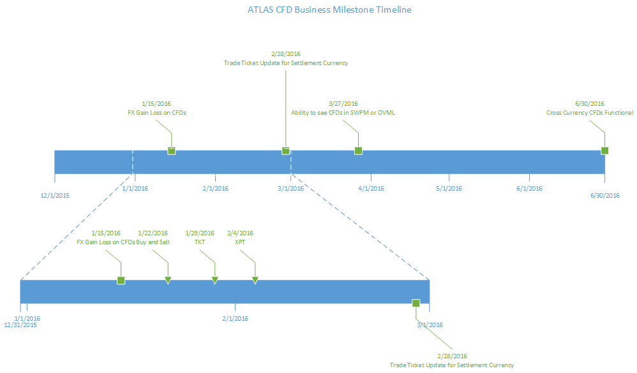
business milestones

Slide 13
CHANGE CONTROL REQUEST
13
CHANGE REQUEST #:
CHANGE REQUEST SUBMITTER: DATE SUBMITTED: ___/___/___
CHANGE TYPE: New Requirement: ___ Requirement Change:___ Enhancement:___ Other:________________
PRIORITY: Emergency:___ Urgent:___ Routine:___ Date Required: ___/___/___
CHANGE DESCRIPTION:
REASON FOR CHANGE:
IMPACT ON SCOPE / DEVELOPMENT / RESOURCES / TIMELINE:
APPROVALS: Change Approved:___ Change Not Approved:___ Hold (Future Enhancement):___ Product Manager: _____________________________________________ Date: ___/___/___ R&D Lead: ___________________________________________________ Date: ___/___/___ PMO Office: __________________________________________________ Date: ___/___/___ Business Head: _______________________________________________ Date: ___/___/___ Ray Tierney: _________________________________________________ Date: ___/___/___

Slide 14
APPENDIX

Slide 15
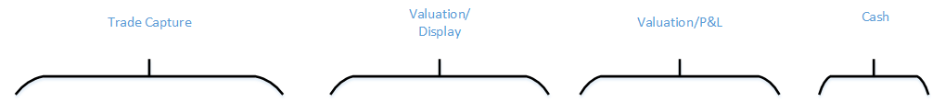
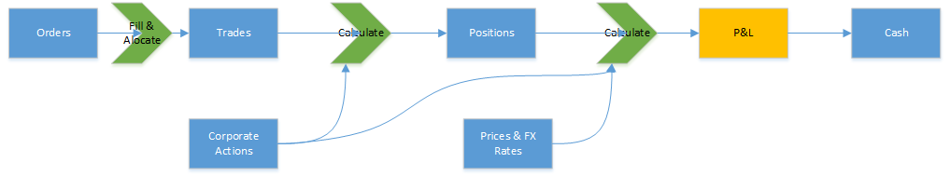
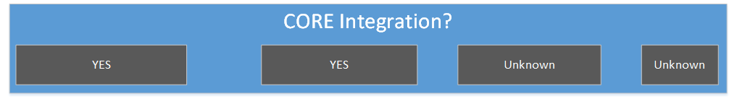
Work Streams

Slide 16
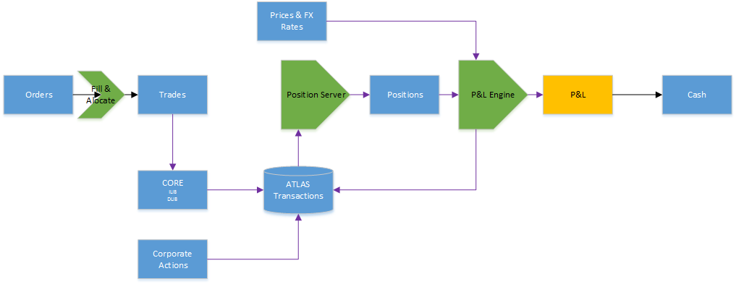
High Level Business Architecture

Slide 17
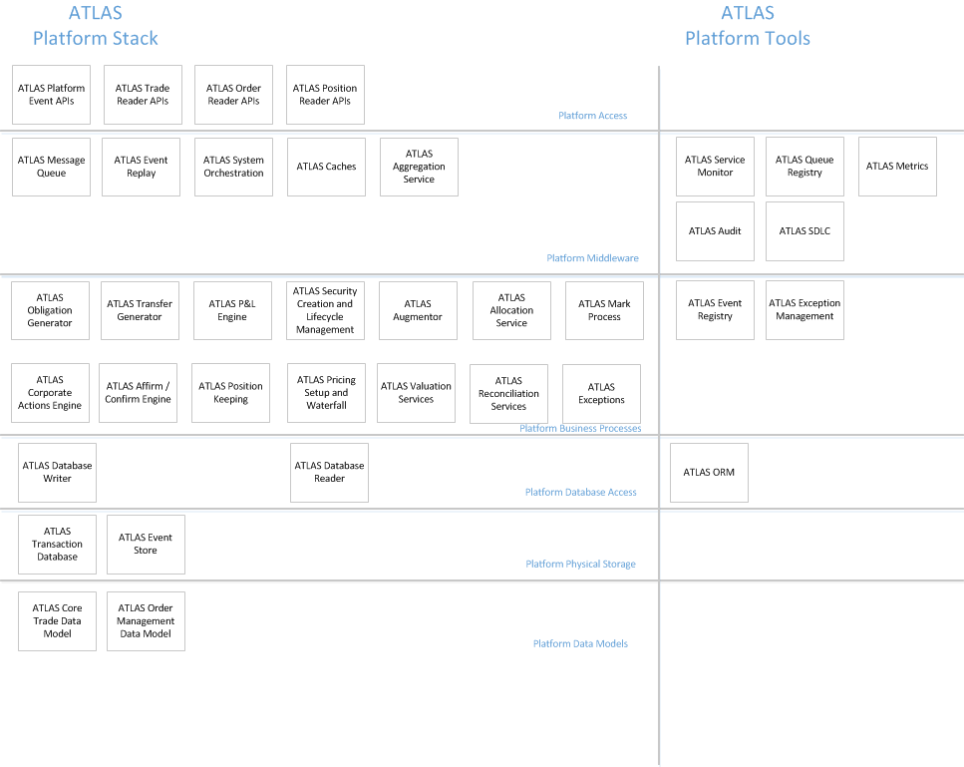
Atlas platform

